Slide 1


Problem Statement: Asset Discovery Tool
Team Name : Team_167
Institute Name: Vignan’s Institute of Information Technology

Slide 2

Team members details
Team Name | Team_167
Institute Name | Vignan’s Institute of Information Technology
Team Members > | 1 (Leader) | 2 | 3
Name | VANGALAPUDI JAHNAVI | KOTI VENKATA SATYA PRAMODA AKHILESH | PANDRANKI SHANMUKHA RAO
Batch | 2022 | 2022 | 2022

Slide 3
Glossary
ssh – secure shell, can be used to support secure logins, file transfers or general purpose connects.
Database – A collection of data.
Nmap – network scanner (tool).
Tech Stack
- Python
- python-nmap (a module used to do network scanning in python )
- flask ( API of python used to build webapps )
- SQLAlchemy ( module used to create and manage sqlite3 database )
- paramiko ( used for ssh client connection)

Slide 4
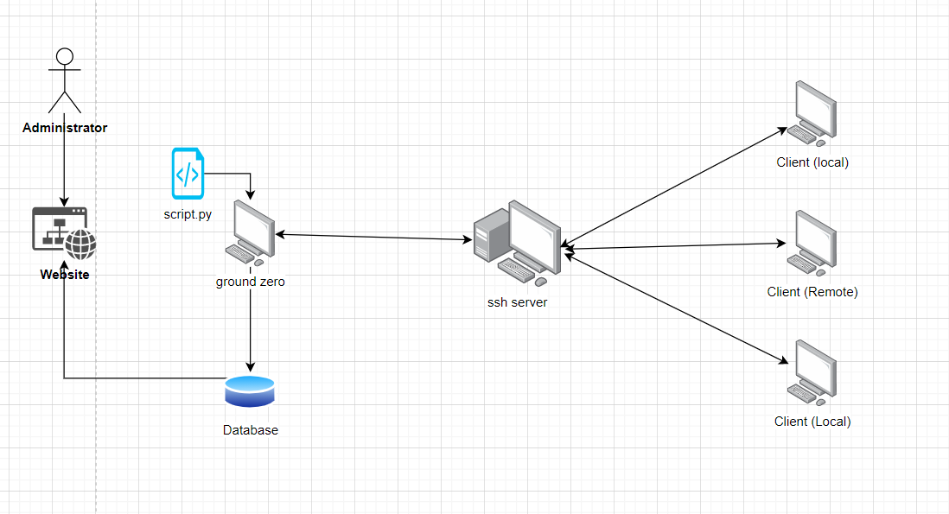
Use-cases
System Architecture

Slide 5
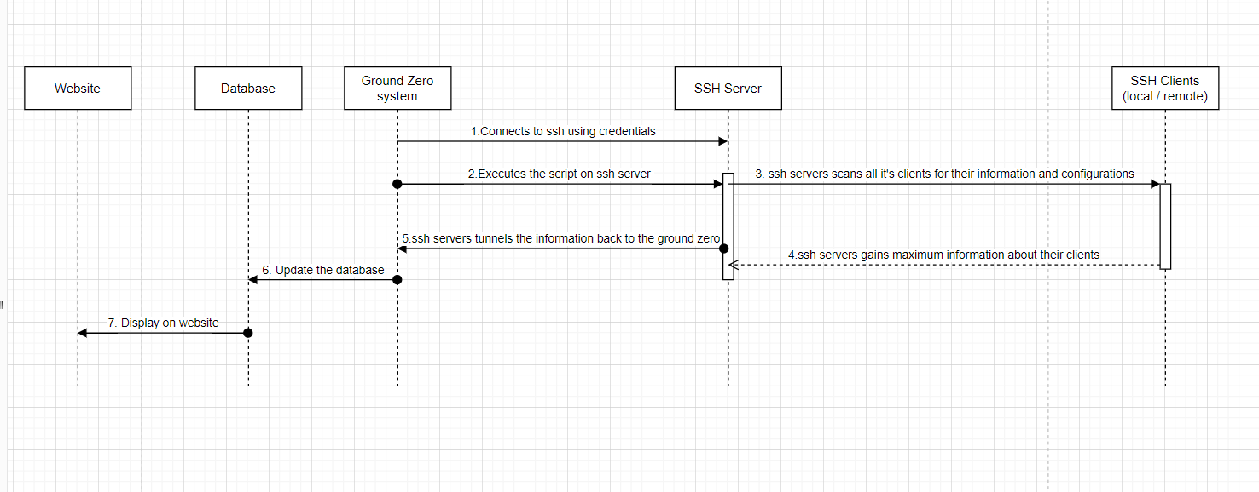
Use-cases
Sequence Diagram

Slide 6
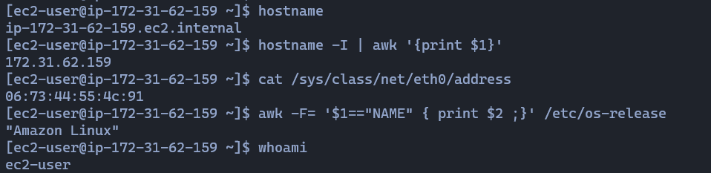
Screenshoots
These commands help us to gather hostname ,IP ,MAC, OS of ssh tunnel running system.

Slide 7
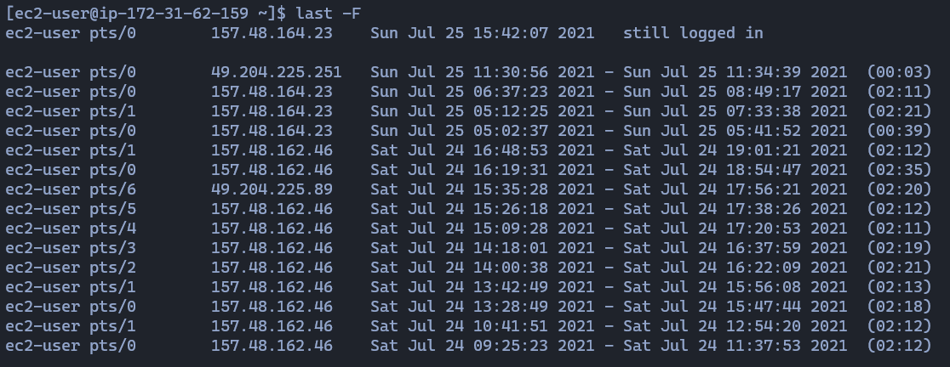
Screenshoots
This command gather all the connected hostnames, IP addresses & last seen information.

Slide 8
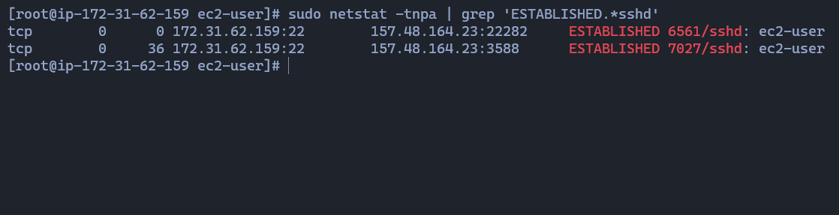
Screenshoots
We gathered extra data of who using source ssh port to get destination port information.

Slide 9
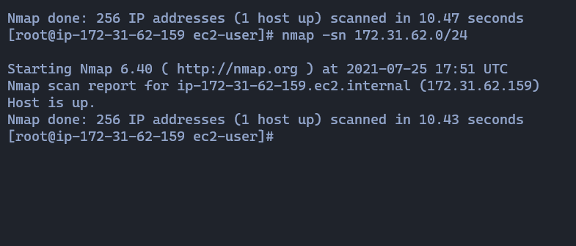
Screenshoots
By using netmask we gather the ip range and used to gather which hosts are up and ther IP,s & MAC address.
sudo nmap -sP 172.31.63.0/24 | awk '/Nmap scan report for/{printf $5;}/MAC Address:/{print " => "$3;}' | sort above command is for gathering exact IP’s and MAC addresses of all subnets.
By using arp-scan package we get faster than nmap which we discovered to get assets.
Command - sudo arp-scan --interface=wlan0 10.0.1.0/24

Slide 10
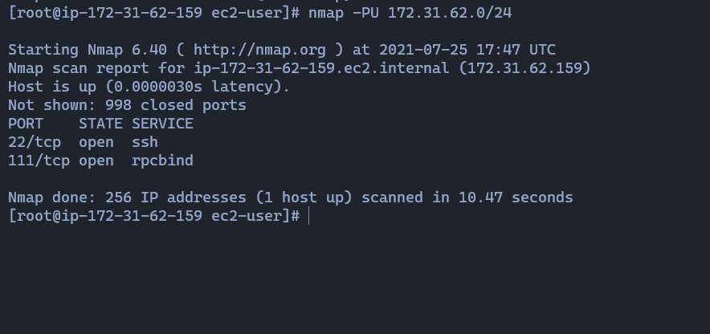
Screenshoots
This command gives us all the subnets of open and closed ports to add into database.

Slide 11
Solution statement/ Proposed approach
We login to the ssh server from the ground zero system.
Now we run the script we have wrote in the ground zero.
The script will first scans the OS type of the ssh server and works accordingly.
Now, the ground zero uses certain commands which first discovers all the local and remote hosts connected to the ssh server.
This information is been gathered by the ssh server and tunnels it back to ground zero.
Ground-zero stores this info in database.
Now ground-zero now makes the ssh server scan individual hosts and get the information such as MAC id, type of OS, the AD or the group in which the host like, last active time and date, IP address.
This information is tunnelled back to the ground-zero and ground-zero updates it back to the database.
Now, the administrator or system administrator can view all this asset discovery information from a website using the data that is periodically updated into the database.

Slide 12
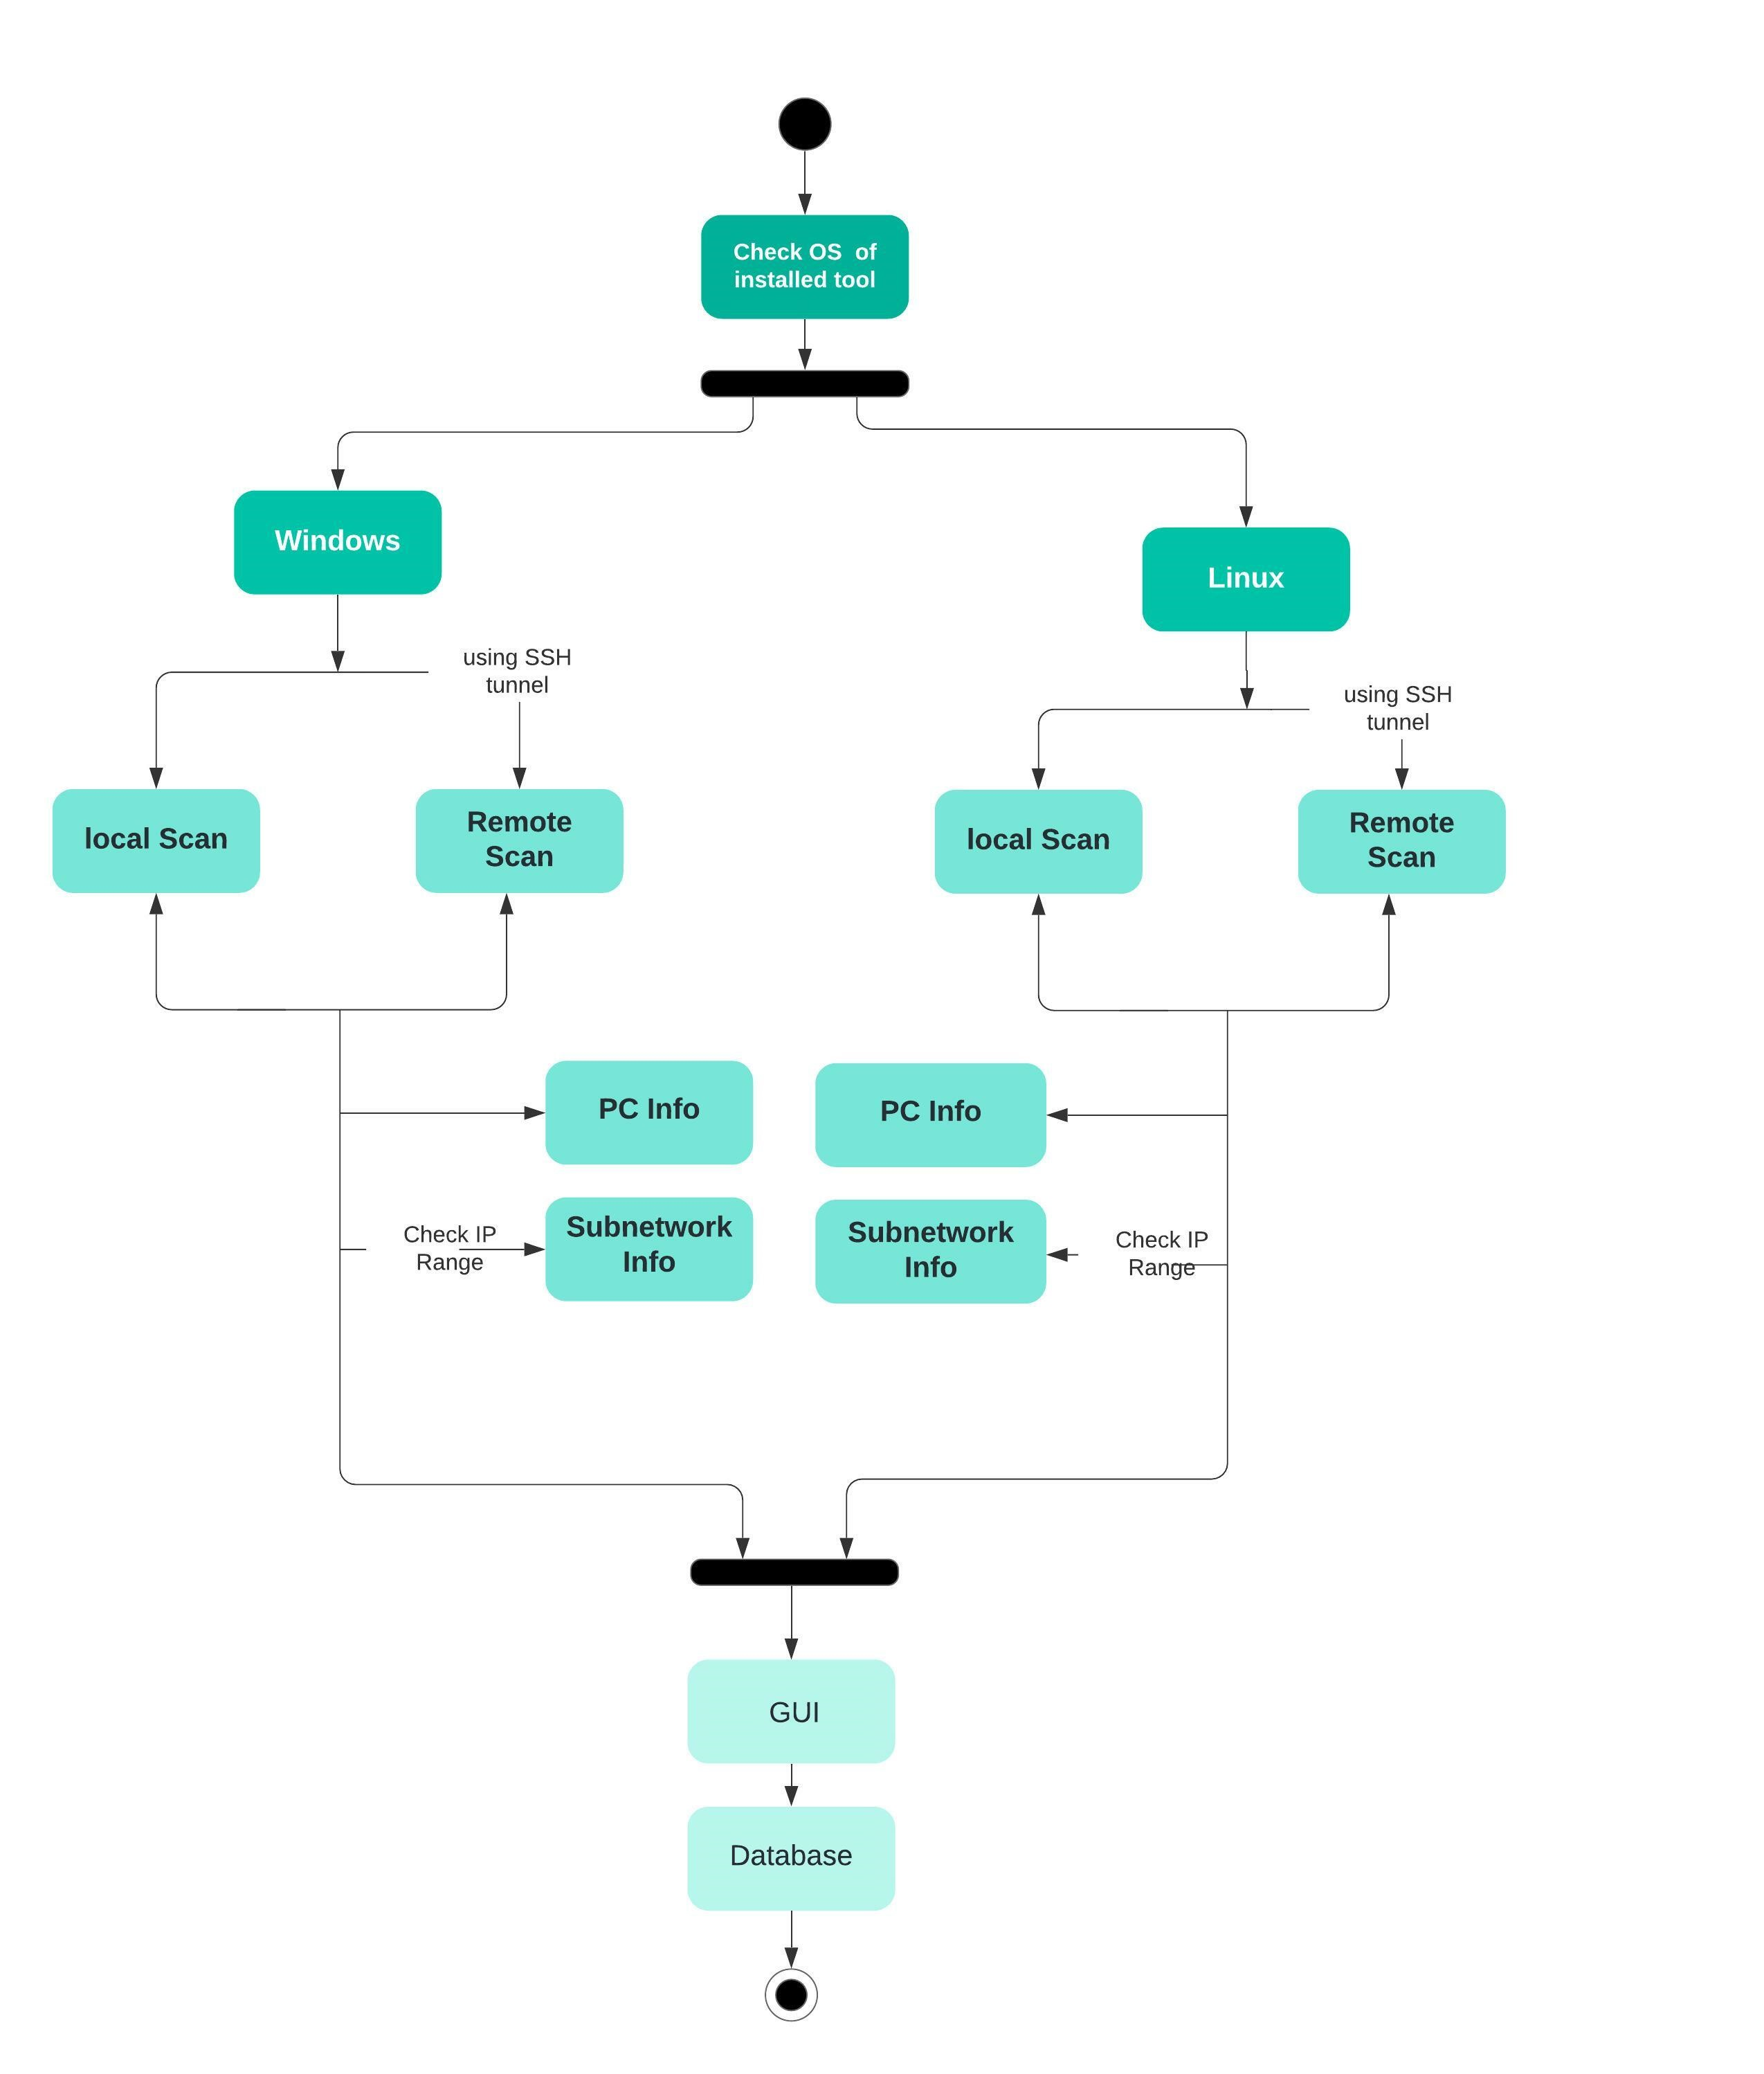
Block Diagram

Slide 13
Limitations
Python should be pre-installed.
We cannot get the info from the hosts if there are no open ports running on the host.

Slide 14
Future Scope
Using this asset discovery tool we can track the users from time to time and find out if any false user or a hacker is been into the system.
We can even log all the activity of a session irrespective of the hostname so that what identity of the user had made that change.

